Slide 1

Preaching Point and Leadership Toolbox App
JESUS Film harvest partners

Slide 2
Table of Contents
I. Installation
II. The App
  1. Navigating the App
  2. Tools
        Tool 1: Bible Studies
        Tool 2: Leadership Modules
        Tool 3: Other Resources
III. Questions

Slide 3


Download App to Follow Along at:
https://discapp.jfhp.org
Or use this QR code
I. Installation

Slide 4
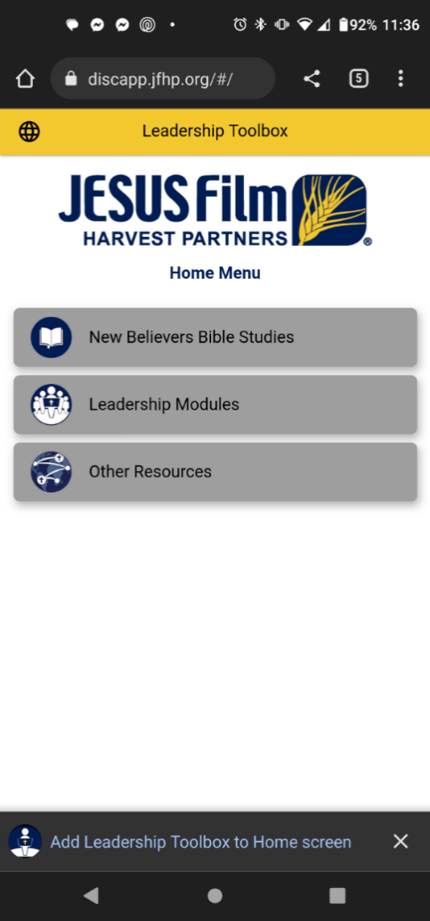
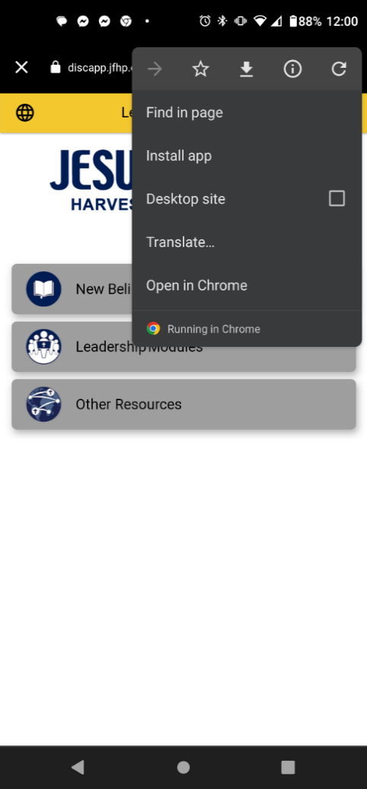
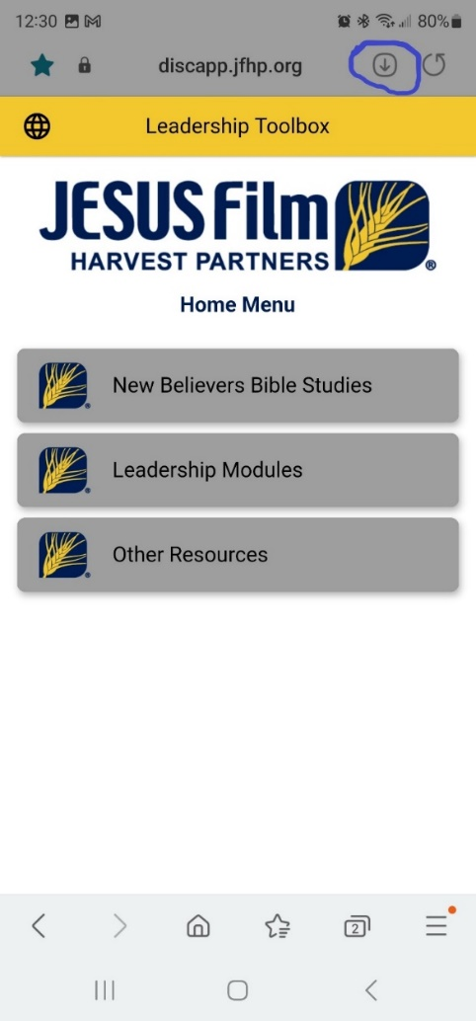
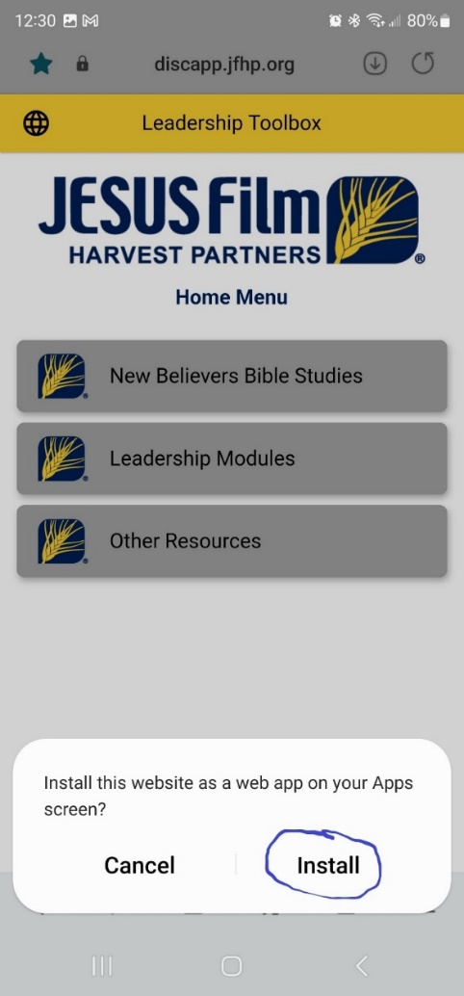
Chrome
Samsung
I. Installation

Slide 5
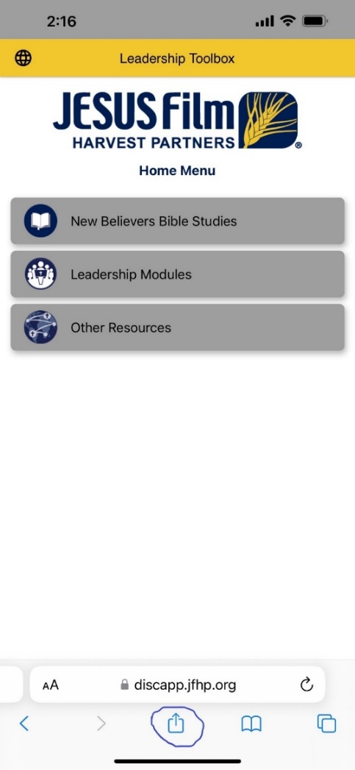
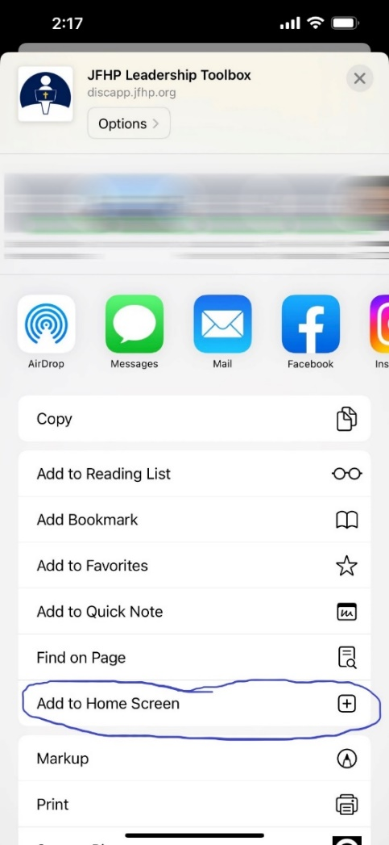
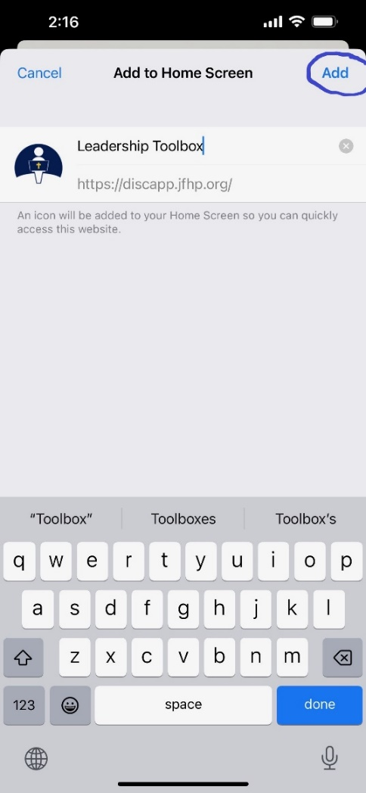
Safari
I. Installation

Slide 6

About the App
Web Progressive App
Access through the Internet, SD Cards, Light Stream
First Wave Languages: English, Spanish, French, Portuguese
Bible Text hyperlinks
II. The App

Slide 7
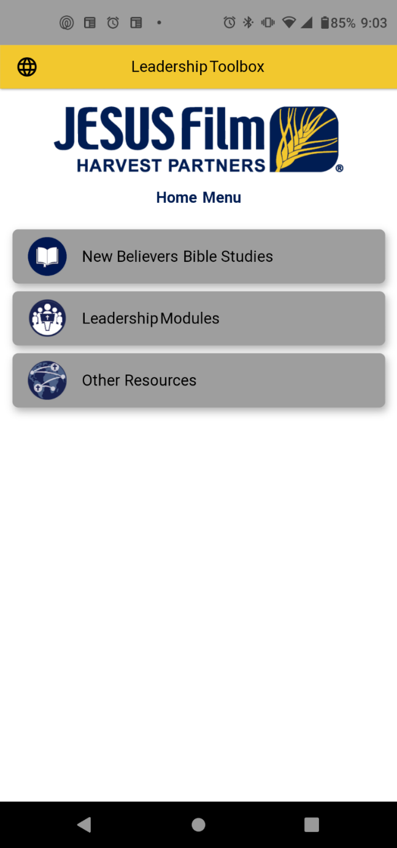
1. Navigating the App:
A. Top Banner
B. Tools
C. Bottom Navigation Bar
1. Navigating the App

Slide 8
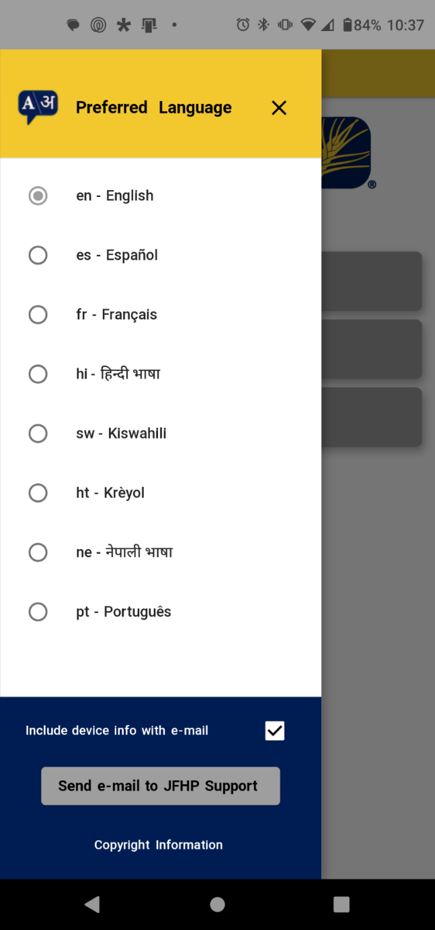
A. Top Banner
• Preferred Language
Note: Except for English, not all resources are available in all languages yet.
• App Support Email
Note: Including “device info with email” will give us information that might help answer questions the user has.
A. Top Banner

Slide 9
B. Tools
• New Believers Bible Studies
108 Bible Studies, covering the Bible from Genesis to Revelation
• Leadership Modules
14 Modules designed to equip Preaching Point Leaders
• Other Resources
Includes: Way Truth Life; Living in the Blessing; Bible Studies on Recovery
B. Tools

Slide 10
C. Bottom Navigation Bar
• Uses your device’s bottom Navigation tools
C. Bottom Navigation Bar

Slide 11
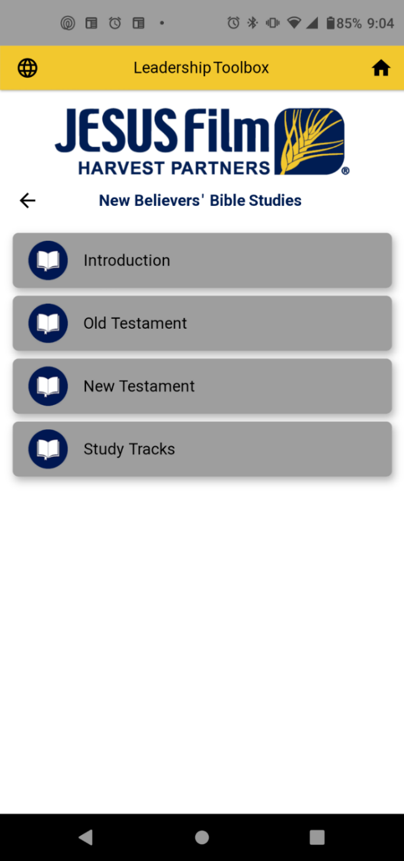
Tool 1: New Believers’ Bible Studies
108 Bible Studies – spanning from Genesis to Revelation
Based on the Story Cloth
Resources for both preparing for and leading Bible studies
Tool 1: New Believers Bible Studies

Slide 12

Tool 1: New Believers’ Bible Studies
Head: What does this text mean?
Heart: Who does the text say we should be?
Hands: How can we
put the Word of God
into action?
Tool 1: New Believers Bible Studies

Slide 13
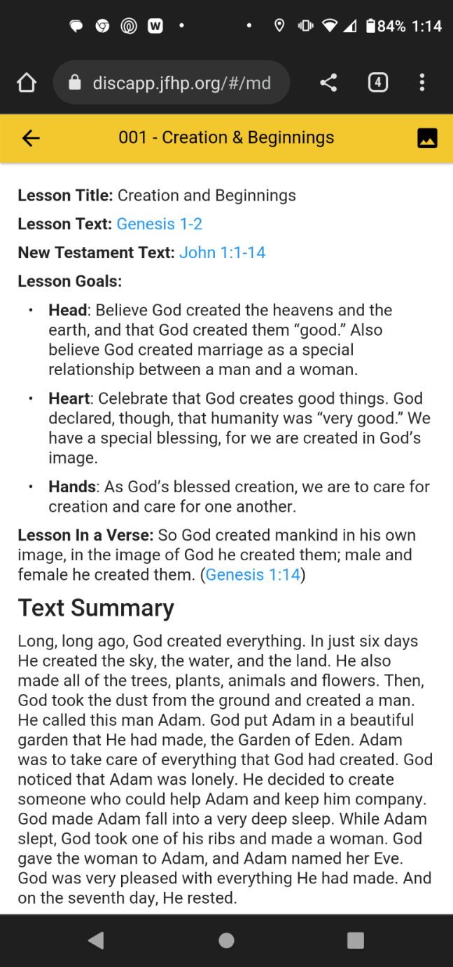
Tool 1: New Believers’ Bible Studies
Each of the 108 Lessons has:
  Introductory Materials
Tool 1: New Believers Bible Studies

Slide 14
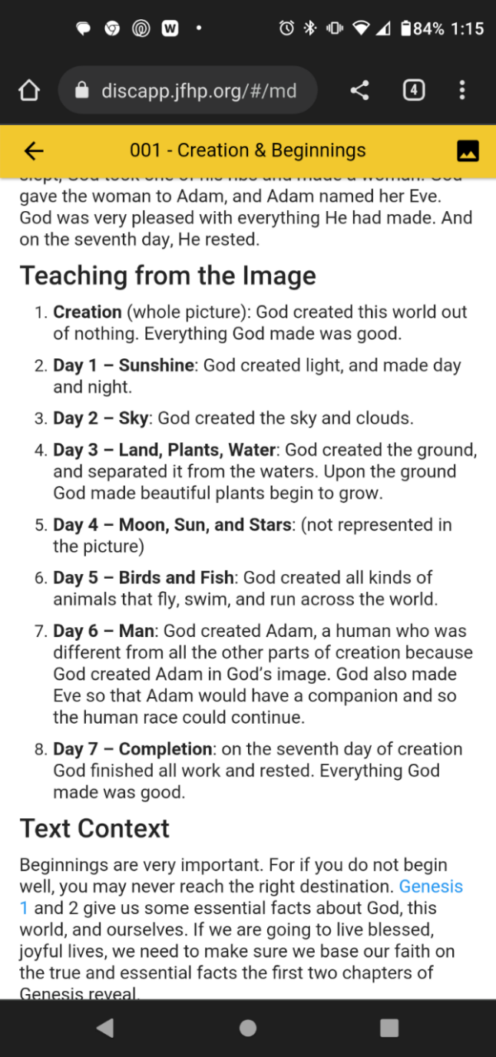

Tool 1: New Believers’ Bible Studies
Each of the 108 Lessons has:
  Introductory Materials
  At least 1 image and a teaching guide for teaching from the image
Tool 1: New Believers Bible Studies

Slide 15
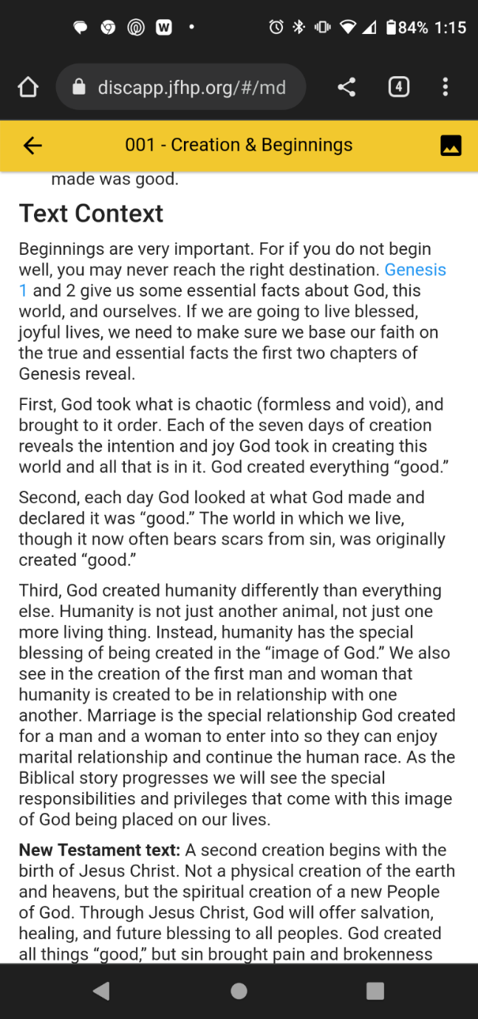
Tool 1: New Believers’ Bible Studies
Each of the 108 Lessons has:
  Introductory Materials
  At least 1 image and a teaching guide for teaching from the image
  Teaching Helps
Tool 1: New Believers Bible Studies

Slide 16
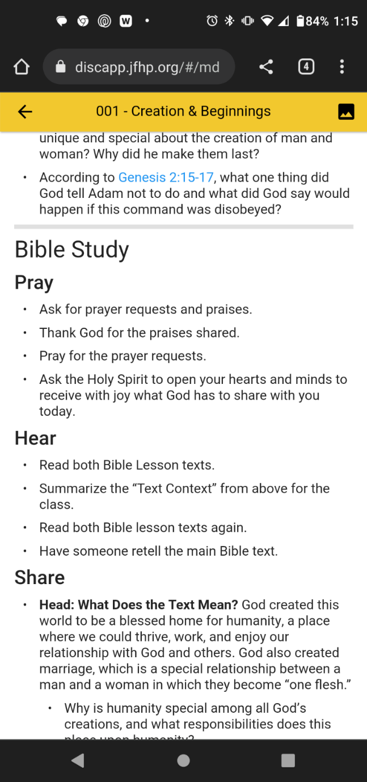
Tool 1: New Believers’ Bible Studies
Each of the 108 Lessons has:
  Introductory Materials
  At least 1 image and teaching hints for the image
  Teaching Helps
  A Bible Study Plan
    Pray, Hear
Tool 1: New Believers Bible Studies

Slide 17
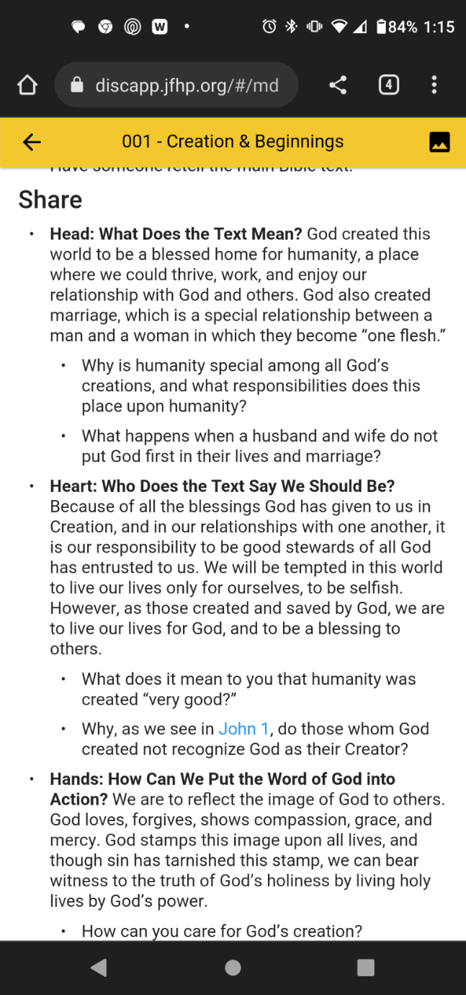
Tool 1: New Believers’ Bible Studies
Each of the 108 Lessons has:
  Introductory Materials
  At least 1 image and teaching hints for the image
  Teaching Helps
  A Bible Study Plan
    Pray, Hear, Share
Tool 1: New Believers Bible Studies

Slide 18
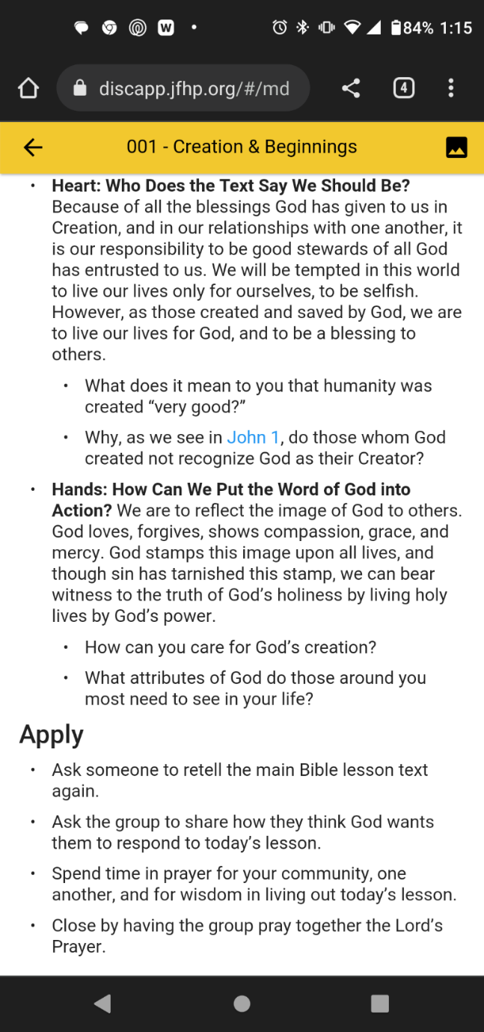
Tool 1: New Believers’ Bible Studies
Each of the 108 Lessons has:
  Introductory Materials
  At least 1 image and teaching hints for the image
  Teaching Helps
  A Bible Study Plan
    Pray, Hear, Share, Apply
Tool 1: New Believers Bible Studies

Slide 19
Tool 1: New Believers’ Bible Studies
Study Tracks
  Meant for short-term Bible studies, or specialized study subjects.
Tool 1: New Believers Bible Studies

Slide 20
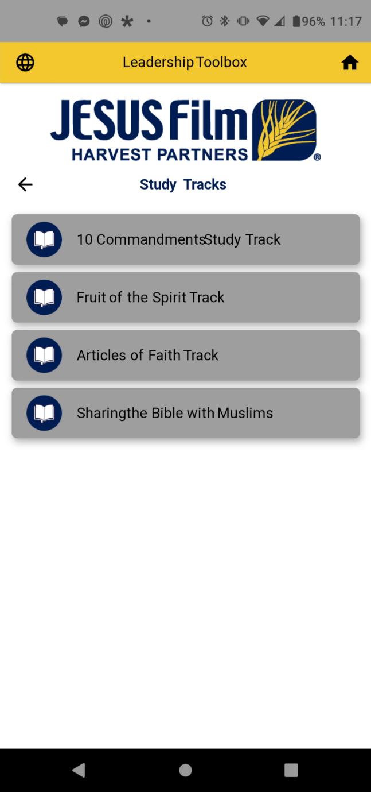
Tool 1: New Believers’ Bible Studies
Study Tracks
  10 Commandments – 11 Studies
  Fruit of the Spirit – 9 Studies
  Articles of Faith – 16 Studies
Tool 1: New Believers Bible Studies

Slide 21
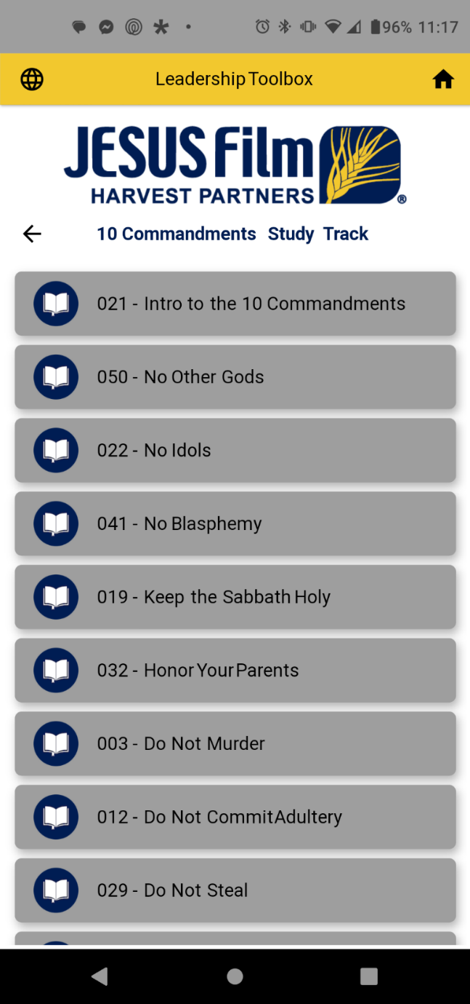
Tool 1: New Believers’ Bible Studies
Study Tracks
  Bible Study number
  Specialized teaching and questions
Tool 1: New Believers Bible Studies

Slide 22
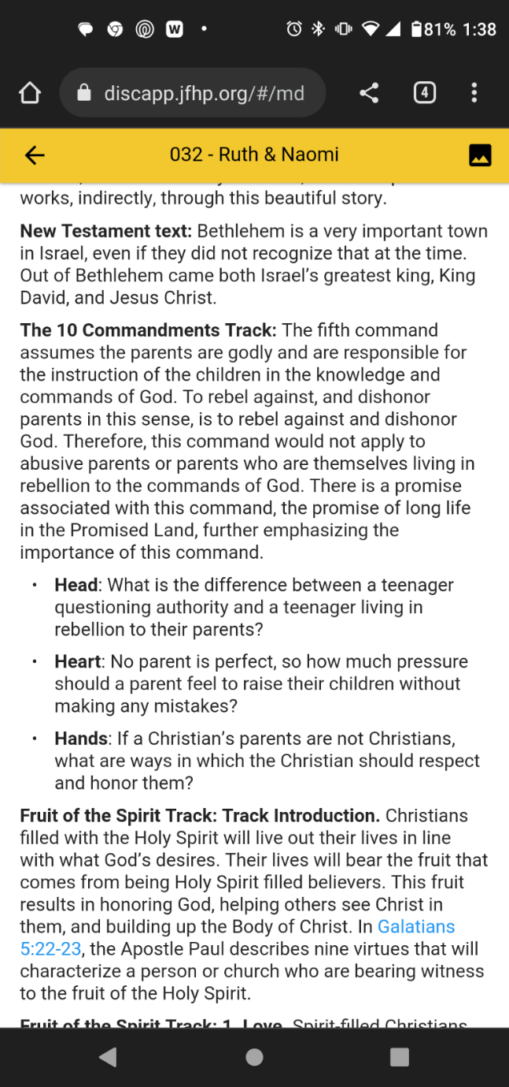
Tool 1: New Believers’ Bible Studies
Study Tracks
  Bible Study number
  Specialized teaching and questions
Tool 1: New Believers Bible Studies

Slide 23
Tool 2: Leadership Modules
14 Modules in 4 Disciplines
Tool 2: Leadership Modules

Slide 24
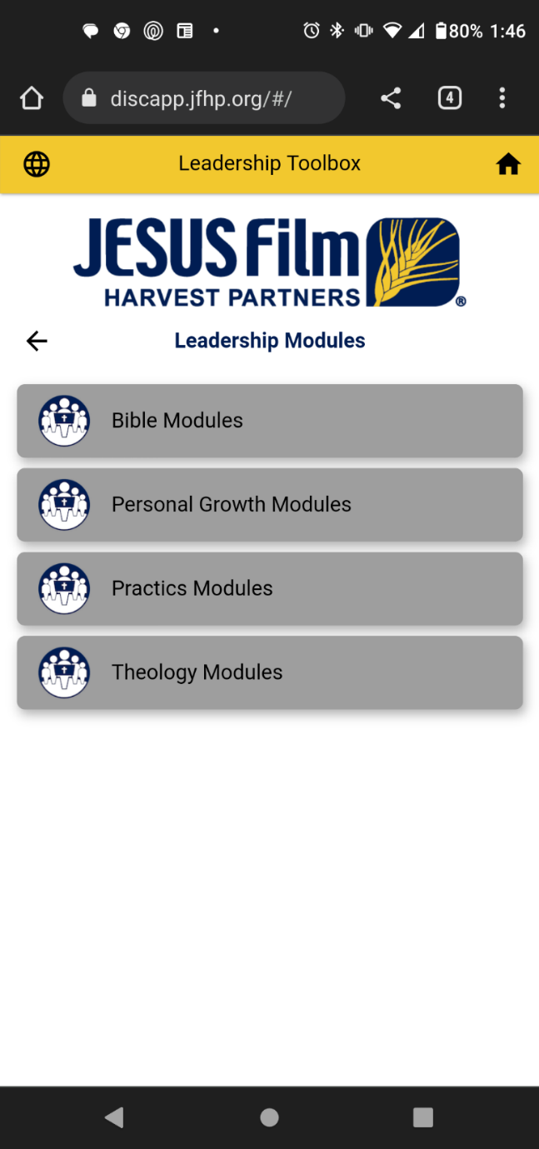
Tool 2: Leadership Modules
14 Modules in 4 Disciplines
  Gathered from many different sources, including curriculum from the
    Mesoamerica School of Leadership
    Clergy Development Course of Study
    The Discipleship Place
    and the book The Kneeling Christian
Tool 2: Leadership Modules

Slide 25
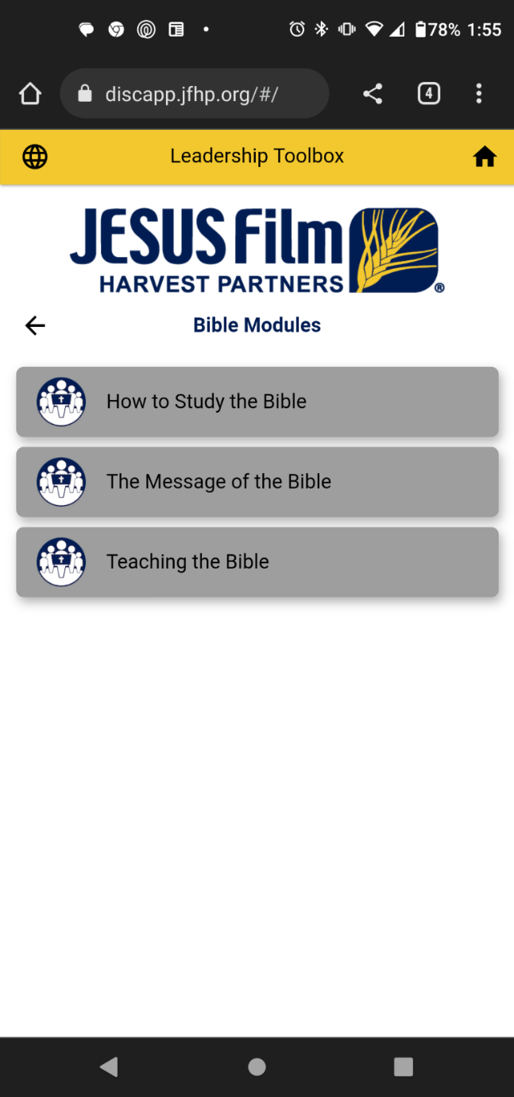
Tool 2: Leadership Modules
3 Bible Modules
Tool 2: Leadership Modules

Slide 26
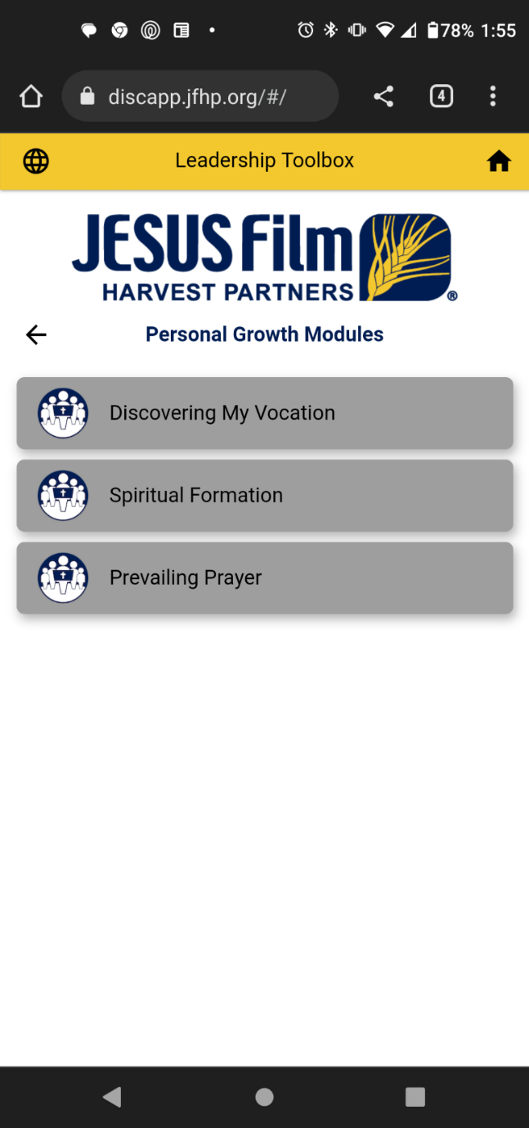
Tool 2: Leadership Modules
3 Bible Modules
3 Personal Growth Modules
Tool 2: Leadership Modules

Slide 27
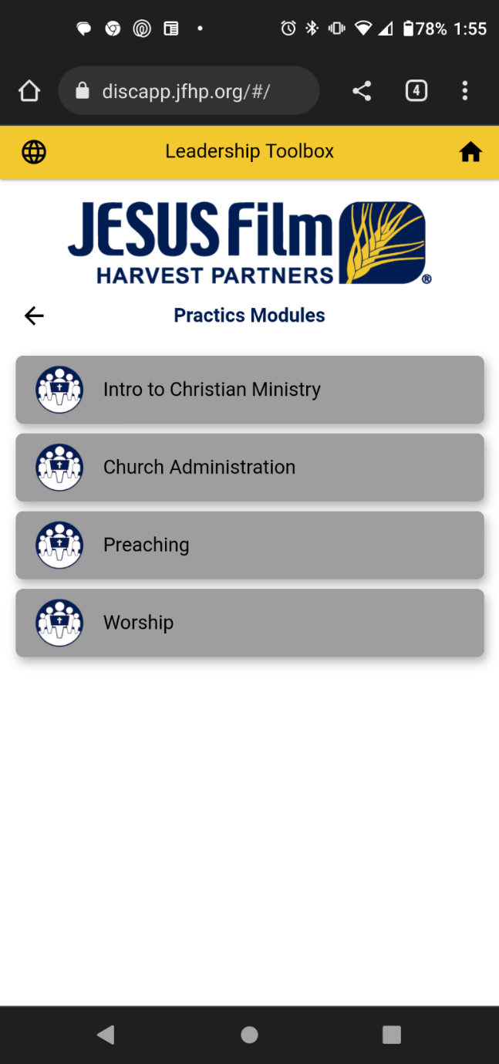
Tool 2: Leadership Modules
3 Bible Modules
3 Personal Growth Modules
4 Practics Modules
Tool 2: Leadership Modules

Slide 28

Tool 2: Leadership Modules
3 Bible Modules
3 Personal Growth Modules
4 Practics Modules
4 Theology Modules
Tool 2: Leadership Modules

Slide 29
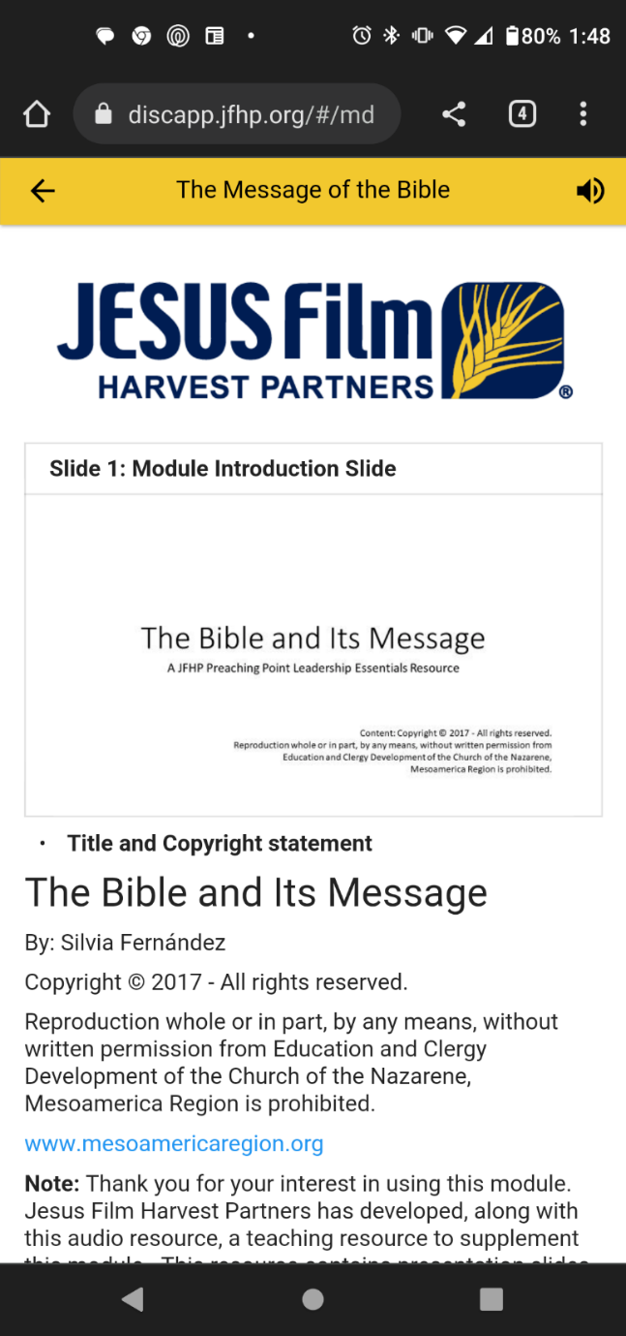
Tool 2: Leadership Modules
Modules are Available (depending on language) as:
  Text Materials
  Audio
  Visual Presentation Slides
Tool 2: Leadership Modules

Slide 30
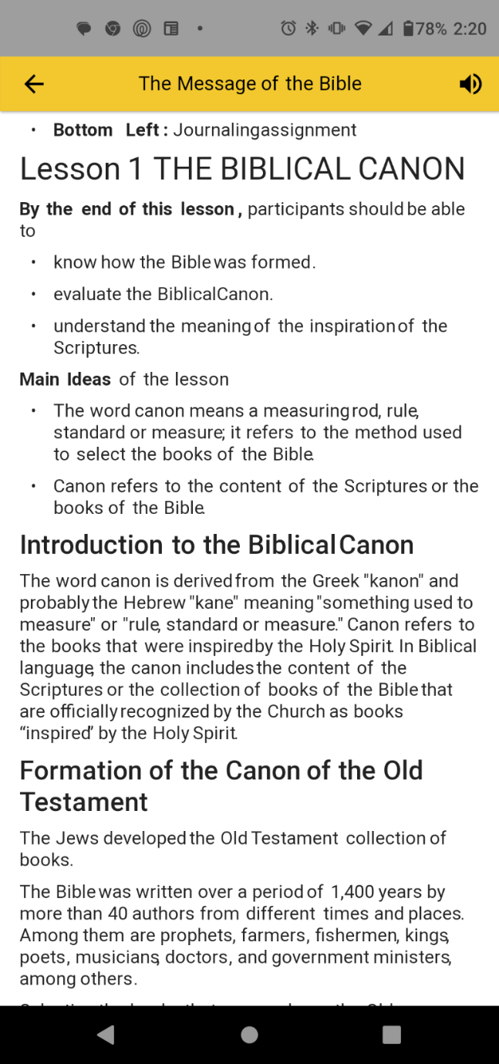
Tool 2: Leadership Modules
Modules are Available (depending on language) as:
  Text Materials
Tool 2: Leadership Modules

Slide 31
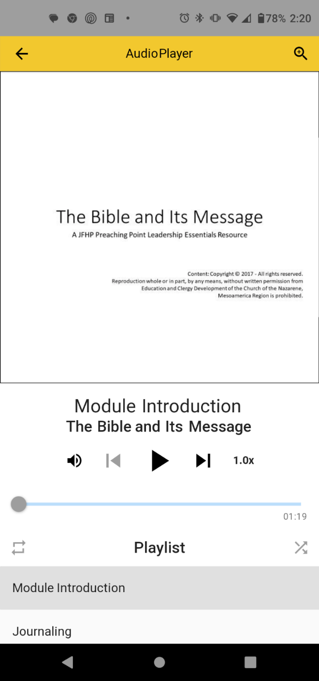
Tool 2: Leadership Modules
Modules are Available (depending on language) as:
  Text Materials
  Audio
Tool 2: Leadership Modules

Slide 32
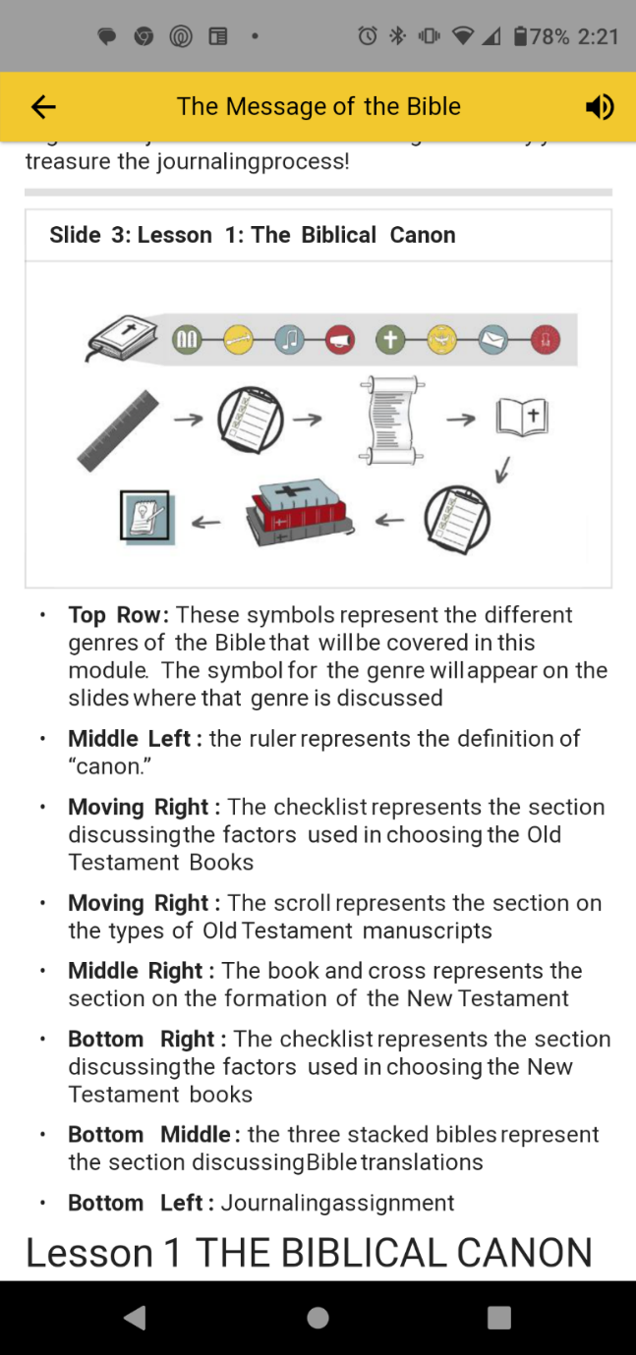
Tool 2: Leadership Modules
Modules are Available (depending on language) as:
  Text Materials
  Audio
  Visual Presentation Slides
Tool 2: Leadership Modules

Slide 33
Tool 3: Other Resources
Tool 3: Other Resources

Slide 34
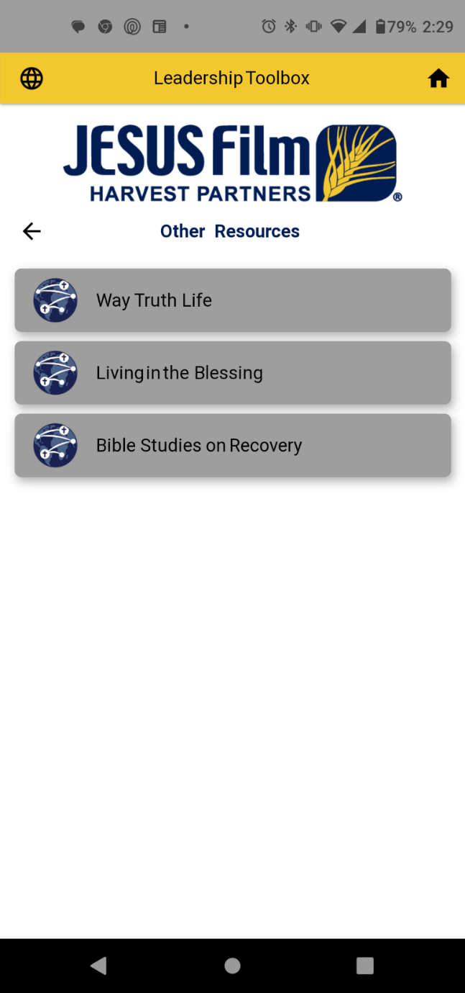
Tool 3: Other Resources
Way Truth Life
  By Dr. David Busic
Living in the Blessing
  365 Daily Devotionals by Dr. Chic Shaver
Bible Studies on Recovery
  A Biblical 12-Step Program
Tool 3: Other Resources

Slide 35
Questions…
III. Questions

