Slide 1

Solitude and Silence
Mark 6: 30-32

Slide 2

Your life is inherently “noisy”

Slide 3
What’s the problem with all this noise?

Slide 4
Jesus practiced silence/solitude regularly

Slide 5
The apostles gathered around Jesus and reported to him all they had done and taught. Then, because so many people were coming and going that they did not even have a chance to eat, he said to them, “Come with me by yourselves to a quiet place and get some rest.”
So they went away by themselves in a boat to a solitary place.
Matthew 6:30-32

Slide 6
Why do we resist it?

Slide 7
Silence/solitude are essential
to healthy roots

Slide 8
How can you discover the value of silence/solitude?

Slide 9


Slide 10
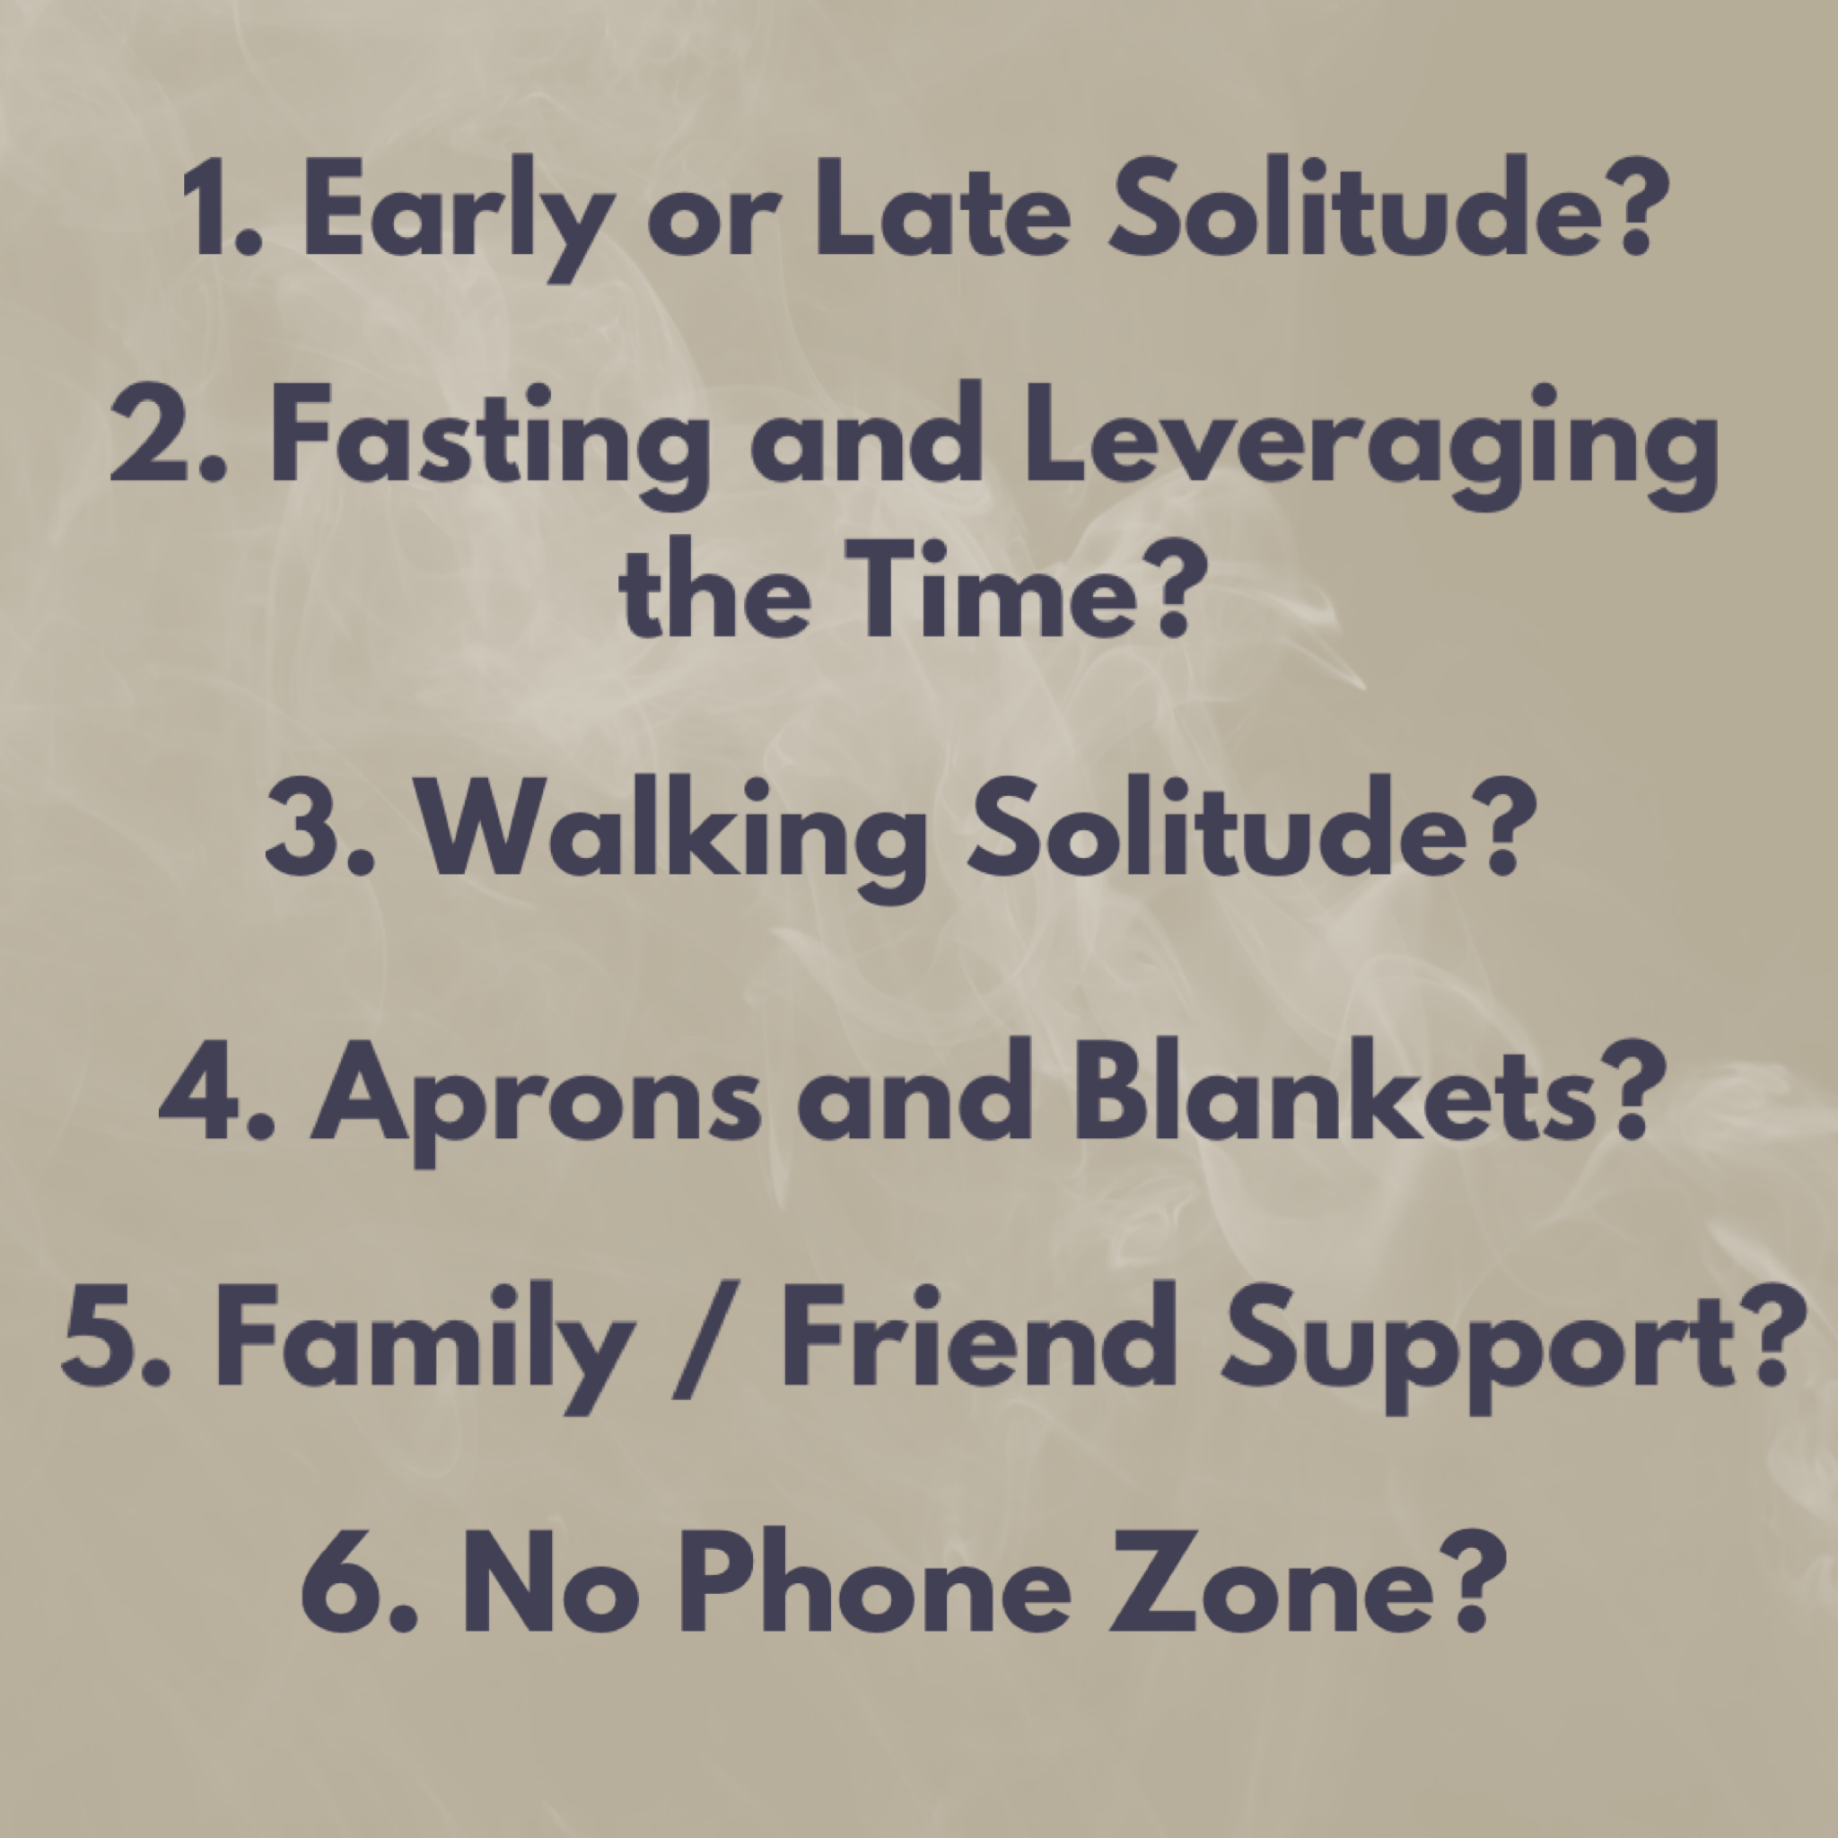

Slide 11
Solitude and Silence
Mark 6: 30-32

